Slide 1
Weekly report: Tower structure
Week number: 03
Date: 14/10/2025
Supervisor: Prof. Faber
Group members: Ibrahim Mostafa, Mohammed Eldemerdash, Kirolls Ghaly
Speaker: Mohammed Eldemerdash (760137)

Slide 2
List of contents
Check Stress of the Tubular Steel structure.
Solutions to overcome transportation of the steel tower .
Handwritten load calculations and stress analysis.
14/10/2025
Group members: Ibrahim Mostafa, Mohammed Eldemerdash, Kirolls Ghaly
Tower structure team/ Optimus Syria

Slide 3
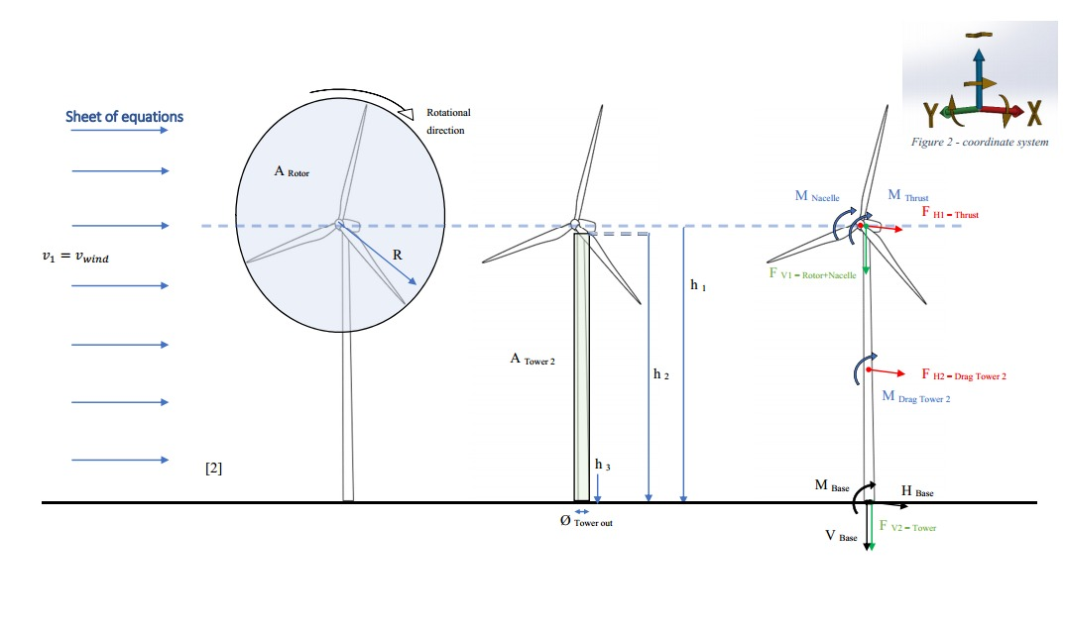
Loads calculations and stress analysis
Source: Prof. Dr.-Ing. Torsten Faber lectures
14/10/2025
Group members: Ibrahim Mostafa, Mohammed Eldemerdash, Kirolls Ghaly
Tower structure team/ Optimus Syria

Slide 4
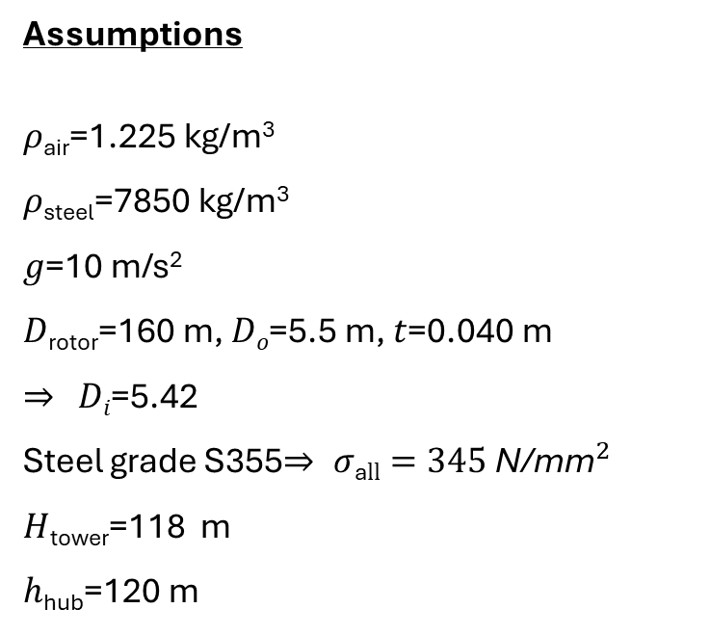
Loads calculations and stress analysis
Assumptions
𝜌_{air}=1.225 kg/m³
𝜌_{steel}=7850 kg/m³
𝑔=10 m/s²
𝐷_{rotor}=160 m, 𝐷_{𝑜}=5.5 m, 𝑡=0.040 m
⇒ 𝐷_{𝑖}=5.42
Steel grade S355⇒ $σ\text{a}ll=345 {\text{N}\text{/}\text{mm}}^{2}$
𝐻_{tower}=118 m
ℎ_{hub}=120 m
𝑚ass_{rotor}=110,000 kg
𝑚ass_{nacelle}=240,000 kg
𝑀oment_{at the top}=33000 kN
𝑀oment_{at the base}=284000 kN
Reference to data assumptions:
-Load and Dynamic team
-https://www.nrel.gov/wind/data-tools
14/10/2025
Group members: Ibrahim Mostafa, Mohammed Eldemerdash, Kirolls Ghaly
Tower structure team/ Optimus Syria

Slide 5
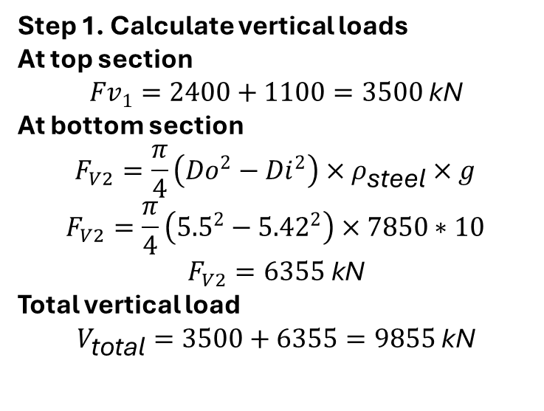
Loads calculations and stress analysis
Step 1. Calculate vertical loads
At top section
$${Fv}_{1}=2400+1100=3500 \text{kN}$$
At bottom section
$$F_{V2}=\frac{π}{4}\left({Do}^{2}−{Di}^{2}\right)×ρ_{\text{steel}}×g$$
$$F_{V2}=\frac{π}{4}\left({5.5}^{2}−{5.42}^{2}\right)×7850∗10$$
$$F_{V2}=6355 \text{kN}$$
Total vertical load
$$V_{\text{total}}=3500+6355=9855 \text{kN}$$
14/10/2025
Group members: Ibrahim Mostafa, Mohammed Eldemerdash, Kirolls Ghaly
Tower structure team/ Optimus Syria

Slide 6
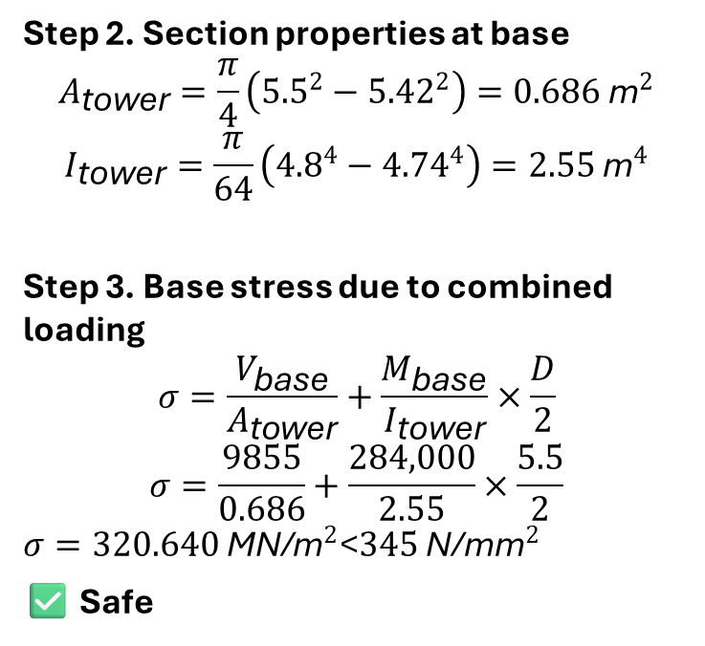
Loads calculations and stress analysis
Step 2. Section properties at base
$$A_{\text{tower}}=\frac{π}{4}\left({5.5}^{2}−{5.42}^{2}\right)=0.686 {\text{m}}^{2}$$
$$I_{\text{tower}}=\frac{π}{64}\left({4.8}^{4}−{4.74}^{4}\right)=2.55 {\text{m}}^{4}$$
Step 3. Base stress due to combined loading
$$σ=\frac{V_{\text{base}}}{A_{\text{tower}}}+\frac{M_{\text{base}}}{I_{\text{tower}}}×\frac{D}{2}$$
$$σ=\frac{9855}{0.686}+\frac{284,000}{2.55}×\frac{5.5}{2}$$
$σ=320.640 {\text{MN}\text{/}\text{m}}^{2}\text{<}345 {\text{N}\text{/}\text{mm}}^{2}$
✅ Safe
14/10/2025
Group members: Ibrahim Mostafa, Mohammed Eldemerdash, Kirolls Ghaly
Tower structure team/ Optimus Syria

Slide 7
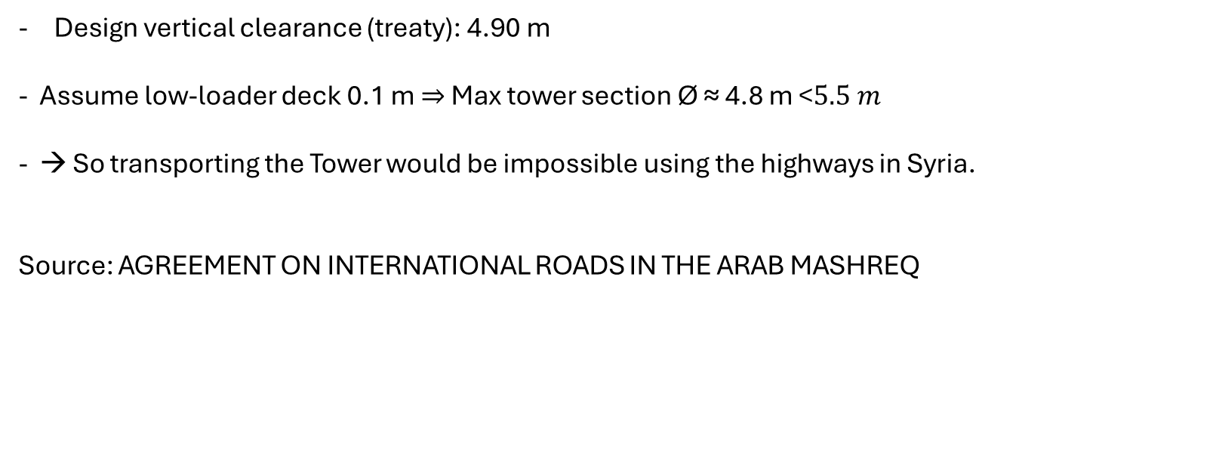
Obstacles of the Transportation, for choosing the Tubular Steel structure.
Design vertical clearance (treaty): 4.90 m
Assume low-loader deck 0.1 m ⇒ Max tower section Ø ≈ 4.8 m $\text{<}5.5 m$
→ So transporting the Tower would be impossible using the highways in Syria.
Source: AGREEMENT ON INTERNATIONAL ROADS IN THE ARAB MASHREQ
14/10/2025
Group members: Ibrahim Mostafa, Mohammed Eldemerdash, Kirolls Ghaly
Tower structure team/ Optimus Syria

Slide 8
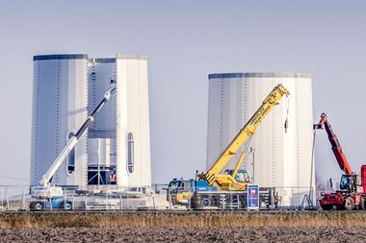
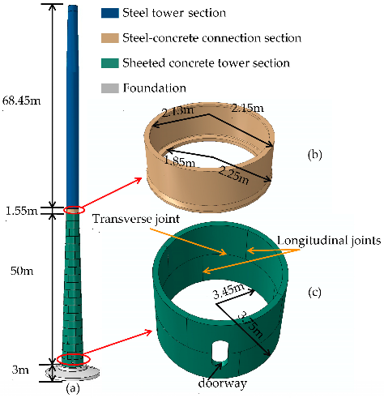
1- A Hybrid tower structure(Concrete bottom, Steel top). 2- Segments of Tubular steel with vertical connections.
For that we came up with two solutions
Source: Enercon
Source: ResearchGate website
14/10/2025
Group members: Ibrahim Mostafa, Mohammed Eldemerdash, Kirolls Ghaly
Tower structure team/ Optimus Syria

Slide 9
Pros: -Lower cost if concrete is cheap. -Very stiff and stable base. -Better damping and corrosion resistance. Cons: -Heavier → harder to transport and lift. -Slower construction. -Complex concrete–steel connection.
Pros and Cons of Hybrid Towers
14/10/2025
Group members: Ibrahim Mostafa, Mohammed Eldemerdash, Kirolls Ghaly
Tower structure team/ Optimus Syria

Slide 10
Pros and Cons of Tubular Steel Segments with Vertical Connections
Pros: -Easy transport and assembly. -Faster construction. -Lighter weight → less seismic loadGood aerodynamic and dynamic behavior. Cons: -Higher steel cost -Needs corrosion protection -Careful inspection for fatigue at splices
14/10/2025
Group members: Ibrahim Mostafa, Mohammed Eldemerdash, Kirolls Ghaly
Tower structure team/ Optimus Syria

Slide 11
Structure system selection
Best Choice “Steel tower with vertical splices”:
-Steel tower with vertical splices.
- faster.
-lighter, and more practical for inland Syria.
14/10/2025
Group members: Ibrahim Mostafa, Mohammed Eldemerdash, Kirolls Ghaly
Tower structure team/ Optimus Syria

Slide 12
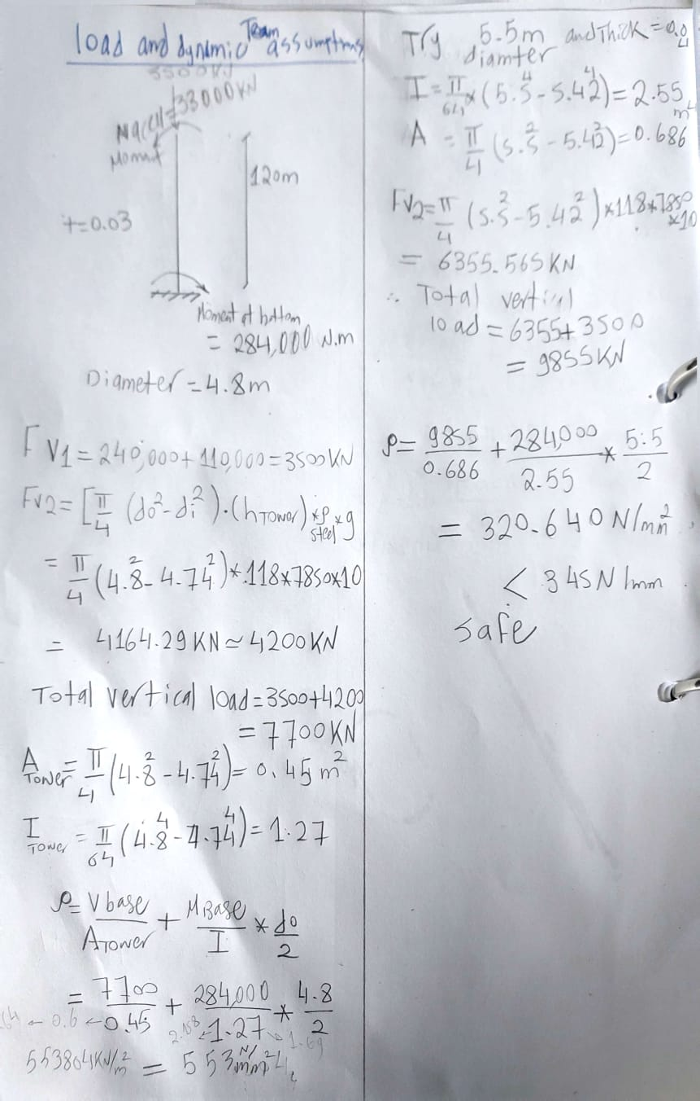
Loads calculations and stress analysis
Fig 10,11: Original handwritten calculations
Group members: Ibrahim Mostafa, Mohammed Eldemerdash, Kirolls Ghaly
Tower structure team/ Optimus Syria

Slide 13
work distribution
Mohammed Eldemerdash:
Comparison between the Hybrid and Tubular Steel Segments with Vertical Connections.
The speaker of the presentation.
Ibrahim Mostafa:
Check the stress.
Prepare the presentation.
Kirollos Ghaly:
- no input
Group members: Ibrahim Mostafa, Mohammed Eldemerdash, Kirolls Ghaly
Tower structure team/ Optimus Syria

